Slide 1

Module 1 - Video 1.1
A quick introduction to
Waze and Waze CCP

Slide 2
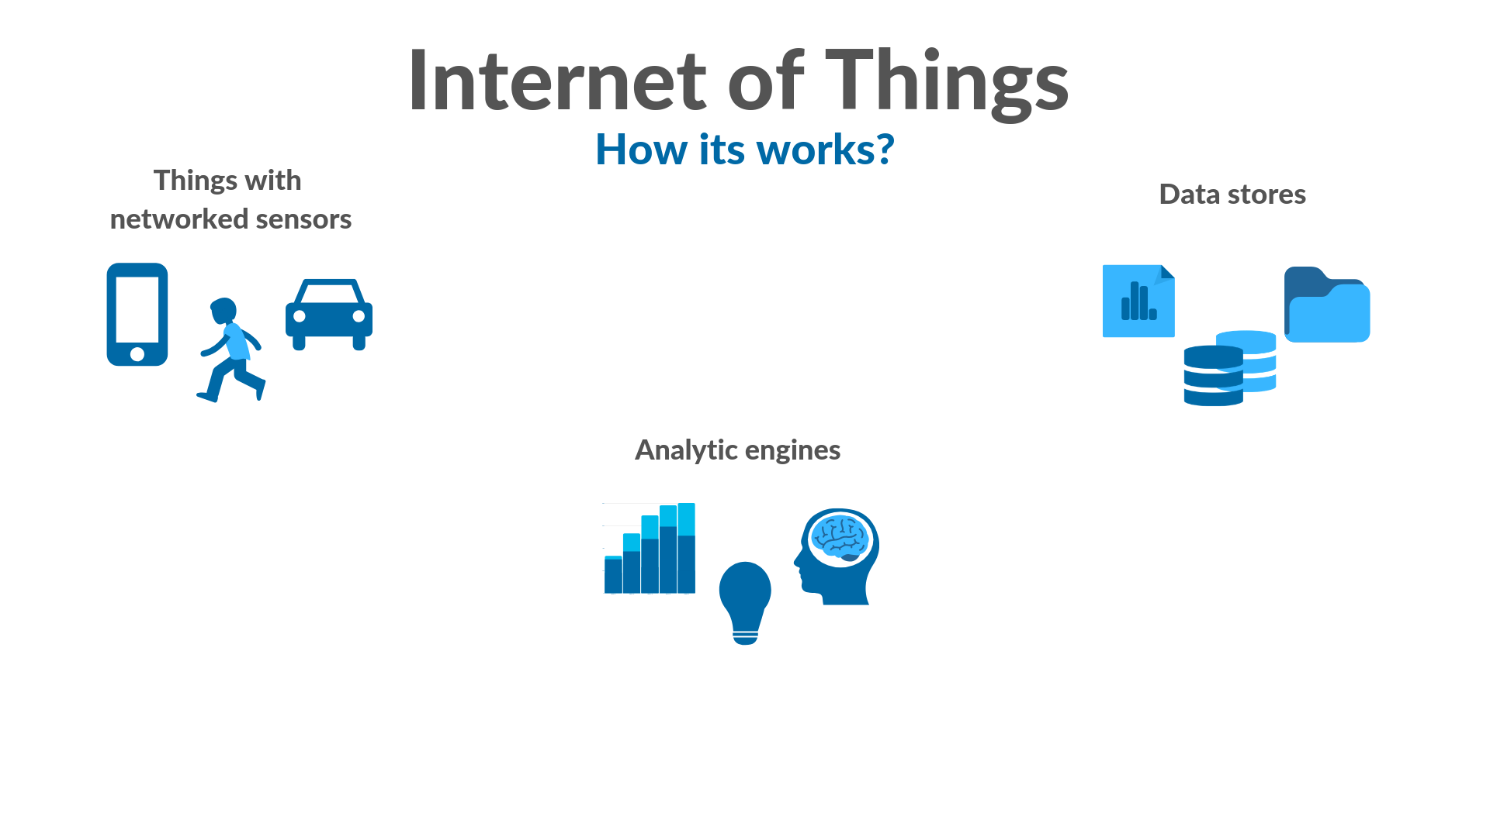
Internet of Things
Report states
Data
storage
Things
connected
to the internet
Analytic engines
Data Analysis
Feedback and controls
Notes:
Hey there
this is the very first video of the very first module of our classes.
In this class we are going to understand that Waze is part of the Internet of things .
After that, I will show that the available waze data for the CCP partners is actually the data that we see on the app everyday.
Then, we are going to dive in the data.
Internet of things is the network of physical devices and other items embedded with sensors, data capture resources and connectivity which enables to exchange data, creating opportunities for a more direct integration.
The things of the internet of things range from cell phones to intelligent watches, from city bikes to buses tracked by GPS.
These things report their states via internet to a central data storage which can be used by analytic engines.
Usually, those analysis are performed to either inform a business or provide feedback to the user.

Slide 3

Waze
Report speed and alerts
Report speed and alerts
Waze App
Waze App
Cellphone
Cellphone
Data Analysis
Data Storage
Community
Traffic Information
Traffic Information
Data Analysis
Data Analysis
Feedback and Controls
Feedback and Controls
Notes:
Waze is a great example of internet of things.
Waze users, who we call wazers, provide information through their cell phones. Besides their geolocation position and speed, wazers actively send alerts to warn other wazers about traffic conditions, road closures, potholes and many more.
All this data is sent to a database through the Waze App. With lots of traffic data generated by wazers, it is possible to perform analysis to identify jams and recommend the best route to reach the desired destination. Also, alerts information is shared with other users to warn them of possible road problems.
However, Waze goes beyond that.

Slide 4

Waze CCP
Report speed and alerts
Cellphone
Waze App
Traffic Information
Feedback and Controls
Data
Analysis
cities improvement
Waze CCP
Waze Community
Information and contributions
Think traffic and urban mobility
Notes:
Besides the common app user, Waze engages a broader community with cities and citizens.
It runs the Waze Connected Citizens Program - CCP which is a initiative of technical cooperation between the waze team, cities and road operators partners to develop solutions with waze data,
The use of Waze data has great potential for in studies and monitoring of traffic performance, road safety, operational conditions, road infrastructure problems, emergency situations and perceptions of road users.
The ultimate goal of CCP is to improve living condition on cities.
Waze also has a encourages users to actively contribute to improve the information about the city map and infrastructure.

Slide 5


Waze
at september, 2018
Drivers
100M+ Monthly Active Users
Map Editors
500K Volunteers
Connected Citizens
700+ Partners
Global Event Partners
280+ Partners
Notes:
Nowadays the Waze community have
one hundred million active users
five hundred thousand map editors
over seven hundred connected citizens partners
and over two hundred and eighty global event partners
Welcome aboard!

Slide 6
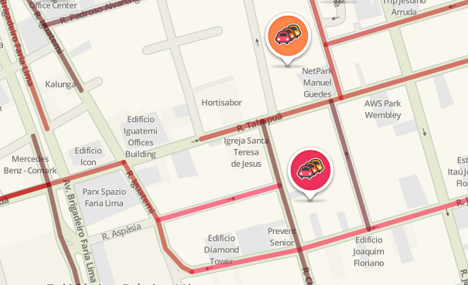
In the nexts videos...
Waze map and data
Jams
Alerts
Irregularities
Notes:
Now, let’s understand what is the data that waze provide to the CCP partners

Slide 7
See you in the next video!

